Slide 1

Credit Card Fraud Detection
CIND 820 Big Data Analytics Project
Anjali Verma
Student number 501223571

Slide 2


Introduction
With the rapid growth of credit card usage, credit card fraud has become a serious issue costing billions of dollars each year. Advanced fraud detection systems will be needed to identify fraudulent transactions.
This study focuses on employing machine learning models, specifically Random Forest, Decision Tree, Logistic Regression, and Naïve Bayes within a supervised learning framework to enhance accuracy in detecting credit card fraud.

Slide 3

Research Questions
Which machine learning algorithms (logistic regression, Decision tree, random forest, Naïve Bayes, etc.) are most effective at detecting different types of fraudulent credit card transactions?
Which transaction type exhibits higher incidence of fraudulent transactions?
What are the most important transaction features that allow machine learning models to accurately distinguish between fraudulent and valid credit card transactions?

Slide 4








Overall Methodology
Data Collection
Data was collected from Kaggle.
Conclusion​
The key findings of the study are summarized, and recommendations for future research are provided
Approach
Data Preparation
Data prepared for analysis
Result Interpretation​
The results of the analysis are interpreted.
Data Visualization​
Perform exploratory data analysis (EDA) to gain valuable insights into the dataset, identify patterns, and understand the relationships between features
Model Evaluation​
Evaluate the trained models using evaluation metrics like Accuracy, precision,Confusion matrix, AUC
Model Selection​
Machine learning techniques decision tree ,logistic regression, Random Forest and Naïve Bayes were used to develop predictive models for credit card fraud detection
Model Training​
The prepared dataset is used to train the models using machine learning algorithms. The time series split cross-validation technique is employed.

Slide 5
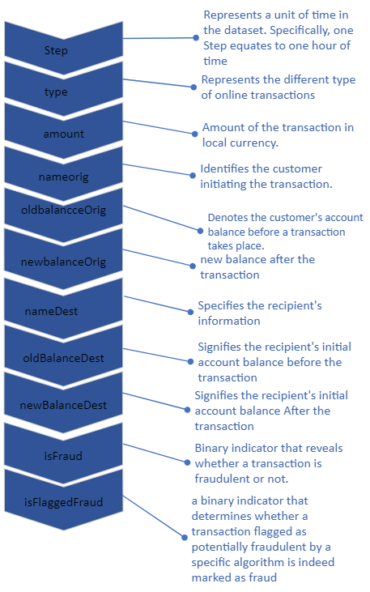
Dataset Summary
Dataset consists of 6,362,320 records with 11 distinct features(6 are Numerical and 5 are Categorical)
"IsFraud" is a target or class variable that determines whether a transaction is fraud or non-fraud.
Dataset has no missing and duplicate values.

Slide 6
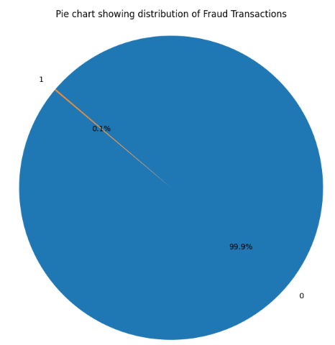
Initial Analysis
In Initial Analysis, it discovered that dataset is imbalance. A mere 0.1% of transactions (8213 number of transactions) are labeled as fraudulent, while the overwhelming majority, 99.9%, are non-fraudulent.
To address this, the Synthetic Minority Over-sampling Technique (SMOTE) will be employed.

Slide 7
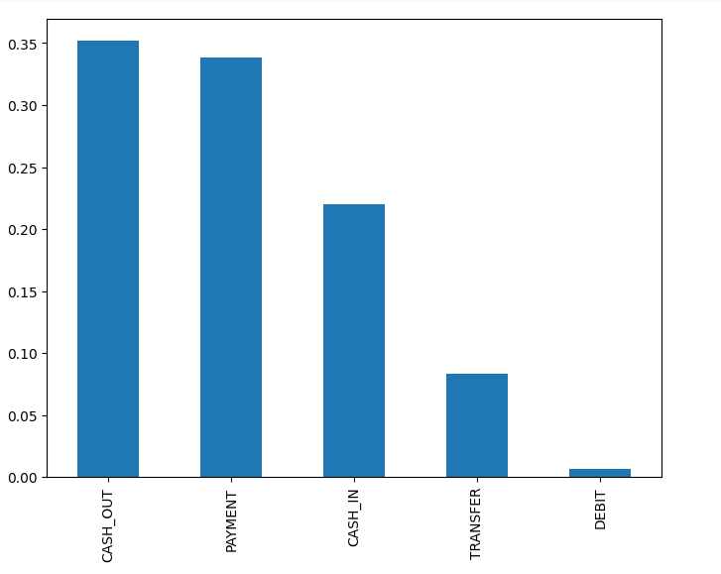
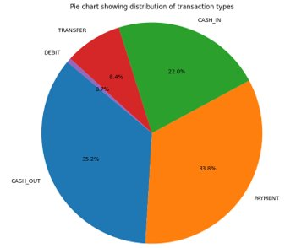
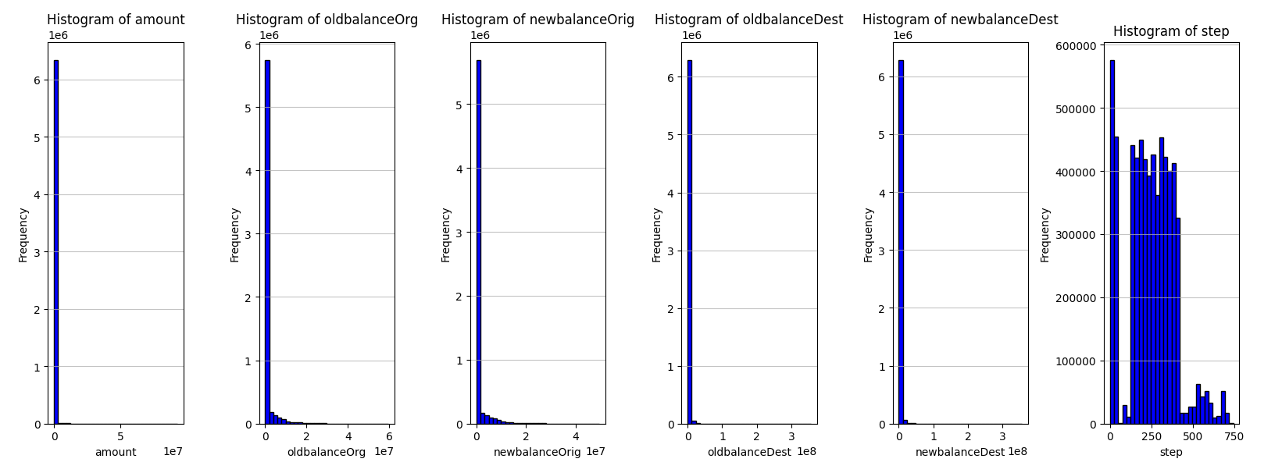
UNIVARIATE ANALYSIS
Most of the transactions take place in "CASH_OUT" and "PAYMENT" type.​
Histograms of numeric variables are plotted.
The findings showed that the data is mostly skewed to the left.

Slide 8
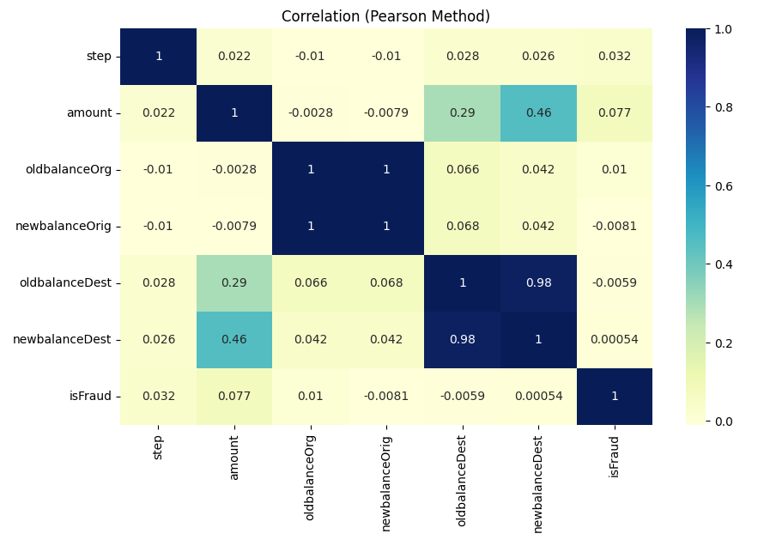
BIVARIATE ANALYSIS
Correlation Matrix
Correlation analysis using the Pearson method, revealing a correlation coefficient of 1 between "newbalanceOrig" and "OldbalanceOrig" variables. This indicates a perfect positive linear relationship, suggesting that as one variable increases, the other variable also increases proportionally."​
​

Slide 9
Exploratory Data Analysis
Normalization using the robust scaler was deemed essential due to the limited amount of fraud data. Traditional outlier removal methods might lead to the loss of vital information in the already sparse fraudulent transactions. The robust scaler, being less sensitive to outliers, enabled normalization while preserving the integrity of fraud-related data.
Research question finding
An analysis of the distribution of fraudulent transactions across different transaction types highlighted that fraud is more prevalent in 'type_CASH_OUT' and 'type_TRANSFER' transactions. Notably, 'type_DEBIT', 'type_PAYMENT' and 'type_CASH_IN' categories showed no instances of fraudulent activities.
type | Fraud count
Cash_out | 4116
Transfer | 4097

Slide 10
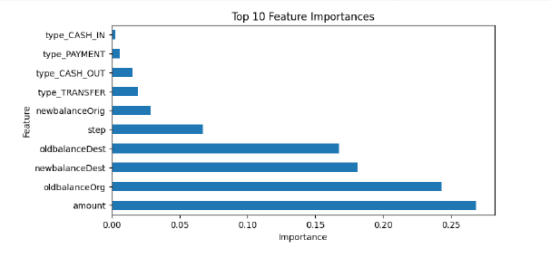
Dimensionality Reduction
Feature importance, determined using a Random Forest Classifier, highlighted the sequence of influential features.
It shows Amount is the most amount transaction feature.
Feature Selection : 'newbalanceOrig' column was removed as the Correlation matrix shows removal of one of the variable between 'newBalanceorig' and 'Old BalanceOrig' would be a good option to avoid multicollinearity issues.Further 'newBalanceorig' is less important feature as compared to 'OldBalanceOrig'.

Slide 11
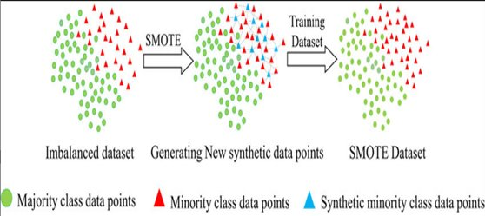
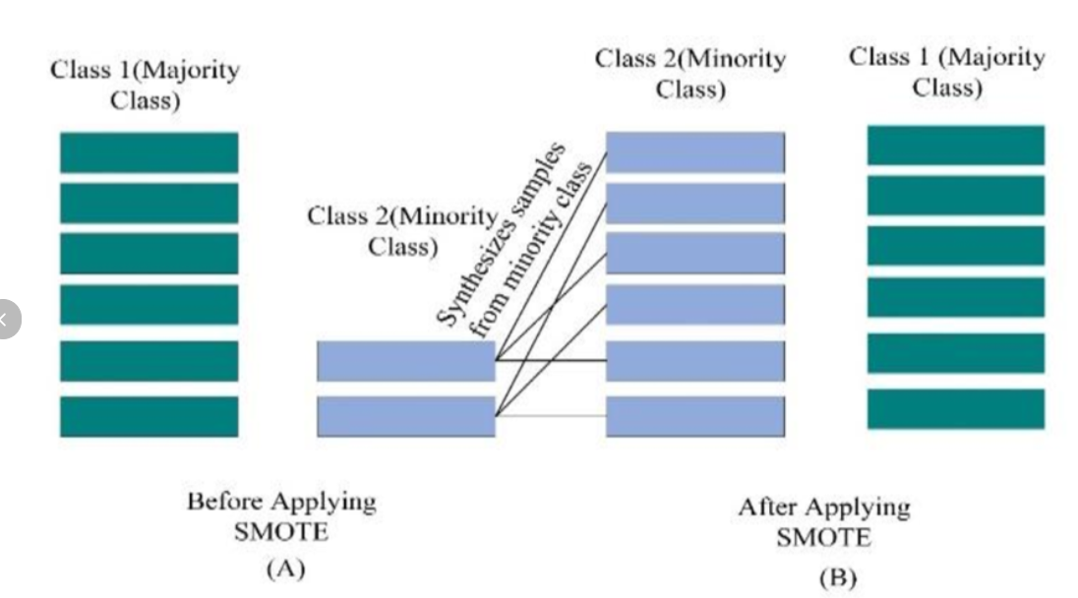
Modeling
To address the imbalanced nature of the dataset, the Synthetic Minority Over-sampling Technique (SMOTE) was applied to the training dataset. SMOTE is crucial in the context of credit card fraud detection because it generates synthetic examples of the minority class (fraudulent transactions) to balance the dataset. This technique helps prevent the model from being biased toward the majority class, thereby improving the accuracy of fraud detection.
By oversampling with SMOTE, the model is exposed to a more balanced representation of both classes. This ensures that the model has sufficient examples of both fraudulent and non-fraudulent transactions to learn from.

Slide 12

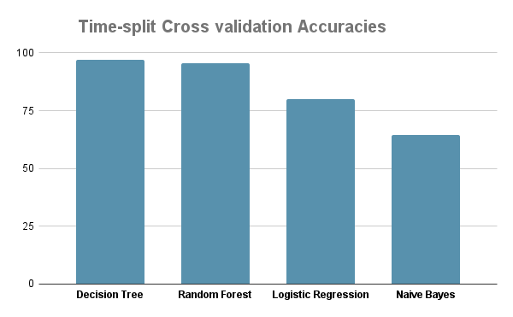



Evaluation
Research question
Which machine learning algorithms (logistic regression, Decision tree, random forest,
Naïve Bayes, etc.) are most effective at detecting different types of fraudulent credit card
transactions?
Time Series Split cross-validation was employed. This proved particularly effective for time-dependent data, preserving the temporal order during cross-validation. By this cross-validation, Decision tree model with average accuracy 96.94 % comes out to be the best performing model .

Slide 13
Evaluation
 | Precision | Recall | F1 Score | AUC
Random Forest | 60.75 | 88.88 | 72.18 | 99.75
Decision Tree | 49.87 | 88.64 | 63.83 | 94.26
Logistic Regression | 0.49 | 66.17 | 0.98 | 86.68
Naïve Bayes | 0.31 | 93.02 | 0.63 | 86.46
Precision :It measures the accuracy of the positive predictions, indicating how many of the instances predicted as positive by the model are actually positive.
Recall :It measures the model's ability to capture all the positive instances in the dataset.
F1 Score: F1 Score provide a balanced measure of precision and recall.
AUC is area under ROC Curve assesses the model's ability to discriminate between positive and negative instances.

Slide 14
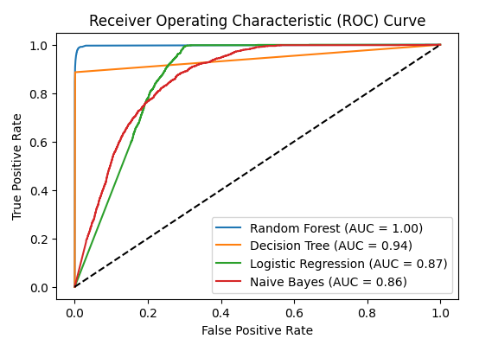
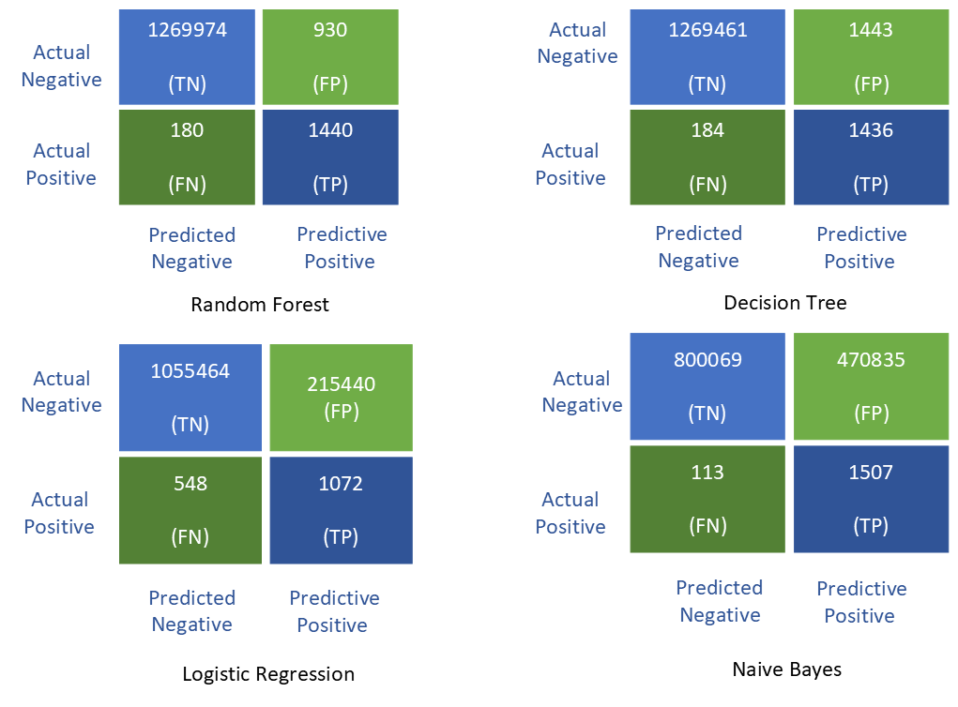
Confusion matrix of all the four models

Slide 15

Conclusion
Even though the accuracy of Decision tree was slighly higher than Random Forest tree, However As Precision is a critical factor (minimizing false positives is crucial) and to consider both false positives and false negatives, the higher F1 Score of Random Forest(72.18% )suggests it might be a better choice to predict fraudulent transactions.

Slide 16
Limitations
Dataset includes lesser valuable attributes.
Class imbalance was another limitation.
The choice of models and the speed of obtaining results were influenced by the available computing capacity and the time required for data analysis.

Slide 17
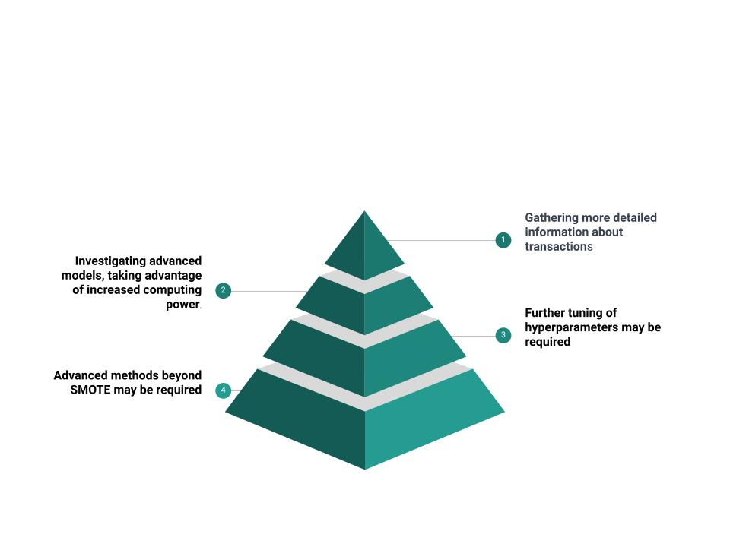
Future Work

Slide 18



Slide 19


